Slide 1
Schrodinger Equation II
PC2232 Lecture 09
Finite Square Wells,
Particle in a Ring & Harmonic Oscillators

Slide 2
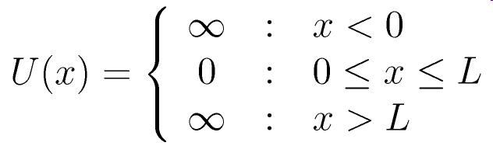
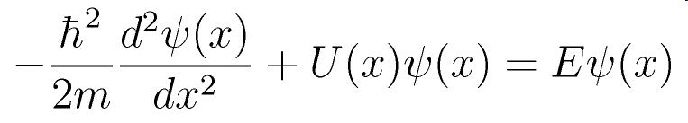
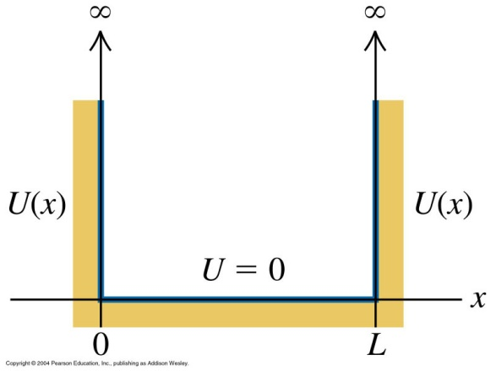
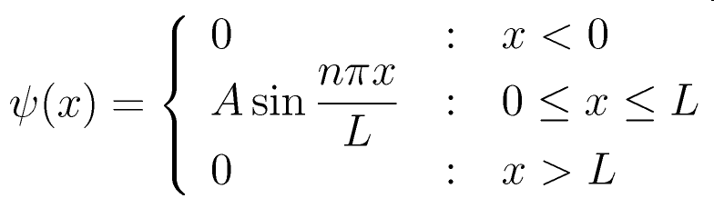
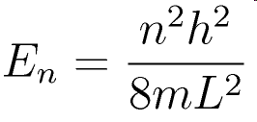
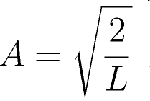
Summary of 1D Infinite Potential Well
We solved completely the Schrodinger Equation for infinite square well:
(by normalization)
(Boundary Conditions)

Slide 3
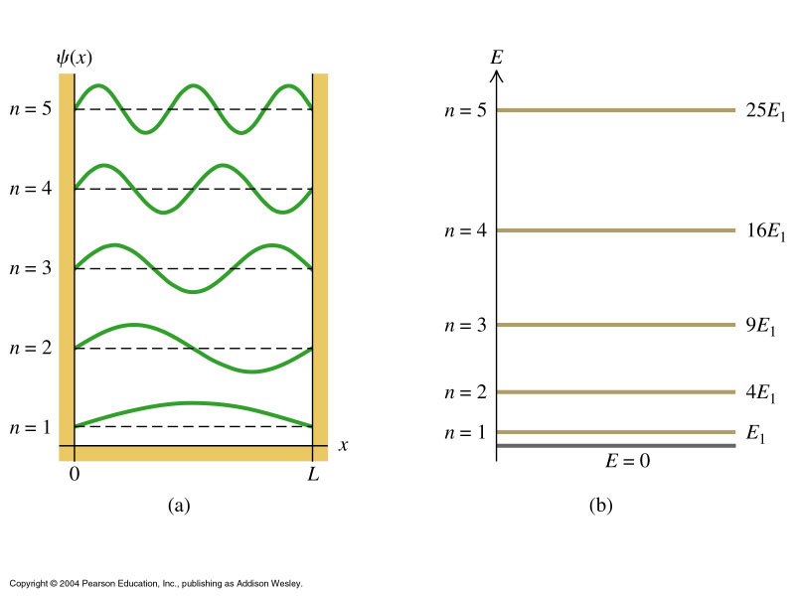
Summary of 1D Infinite Potential Well

Slide 4
Finite Square Potential Well

Slide 5
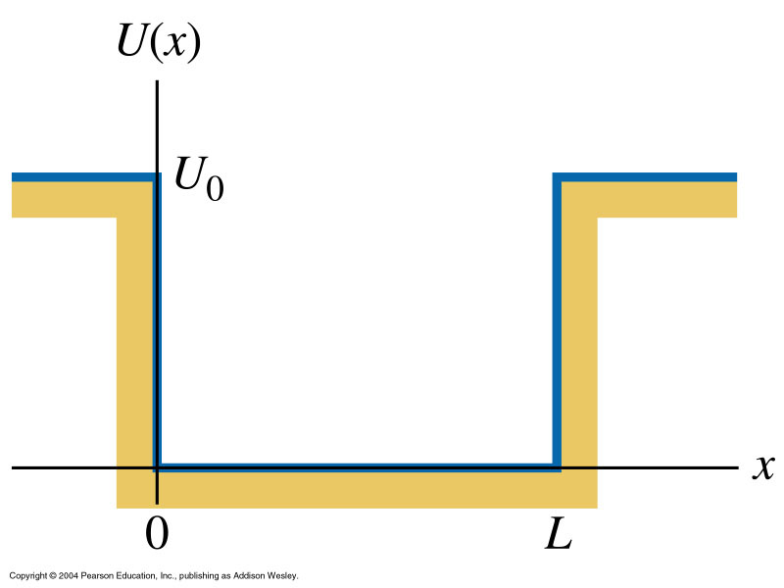
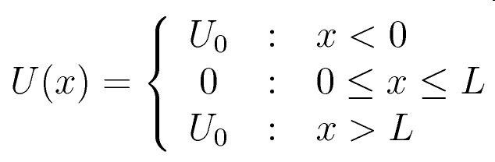
Finite Square Potential Well
The infinite potential square well is a mathematical idealization of some physical cases. A more realistic model is one in which the potential outside the box is a constant and finite value U₀.
While it looks quite similar to the earlier case, mathematically, it is a lot more demanding and we will not be able to solve it analytically. At the same time, it exhibits another quantum phenomenon not explainable by classical theories. We should of course get the infinite case as the limit when U₀ → ∞ from our analysis of the finite potential case.

Slide 6
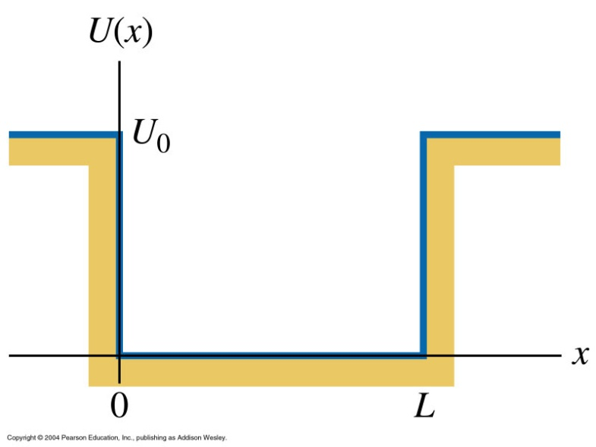
Finite Square Potential Well
There are two energy ranges of interest to us.
  E ≤ U₀
  E > U₀
We will concentrate on case (i) where the particles are “confined” within the walls.

Slide 7
Finite Square Potential Well
The first difference between this and infinite potential well is that we can no longer assume that ψ(x) = 0 for x < 0 or x > L, in spite of the fact that classically it implies KE < 0, for E < U₀.
However, we expect that in these two regions, the wave function should approach zero relatively fast so that the integral of |ψ(x)|² does not go to infinity – which defies its definition as probability density.
In the region 0 ≤ x ≤ L, we still expect sinusoidal relationship as the Schrodinger Equation is exactly the same as the infinite well.

Slide 8
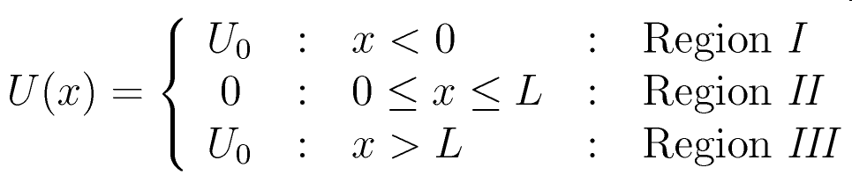
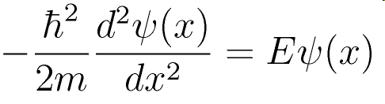
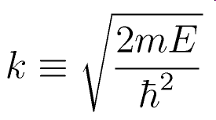

Wave Functions at Region II
Let us divide the problems into the three different regions as indicated below:
I
II
III
In region II, the SE is
And as before, the general solution is:
where
We may no longer assume B = 0 since ψ(0) ≠ 0.

Slide 9
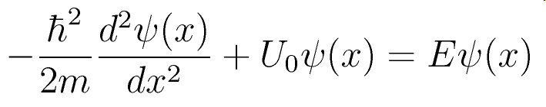
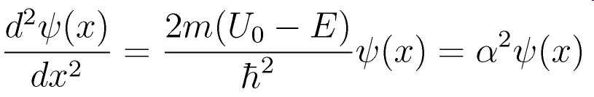
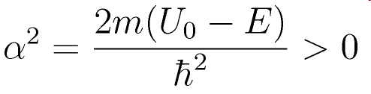
Wavefunctions at Regions I & III
In Regions I & III, the Schrodinger Equation is:
where
Note that some textbook uses different symbol for this parameter.
I
II
III

Slide 10
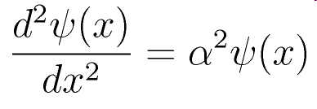

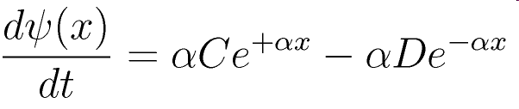
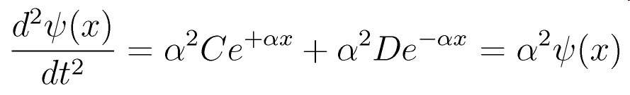
Wavefunctions at Regions I & III
The general solution for
is
It is easy to verify that the above is a solution to the SE:
I
II
III

Slide 11




Wavefunctions at Regions I & III
There is no reason for the constants C and D to be the same for both regions I and III. So let us write the solutions separately:
Note that ψ_{I}(x) → ∞ when x → – ∞ if D ≠ 0. Similarly
ψ_{III}(x) → ∞ when x → ∞ if F ≠ 0. Therefore D = F = 0.
Thus we have:
I
II
III

Slide 12
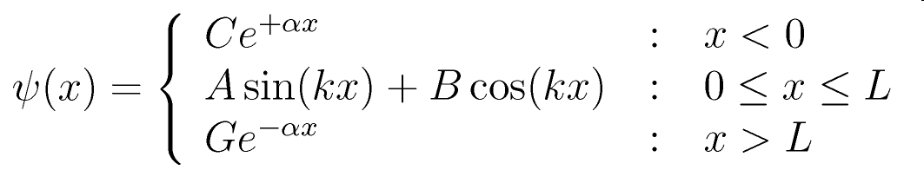
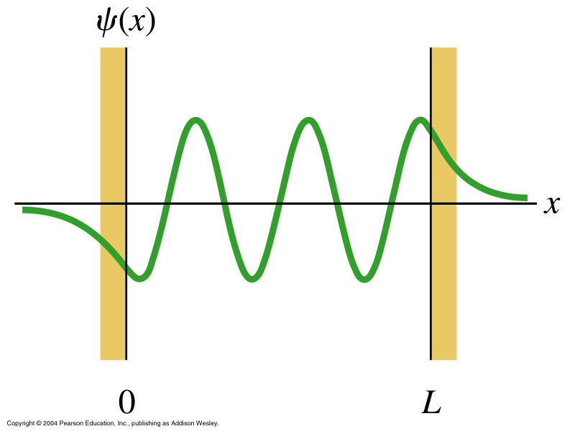



Combined Solution
Therefore the combined solutions are as follows:
Below is one possible solution
I
II
III

Slide 13


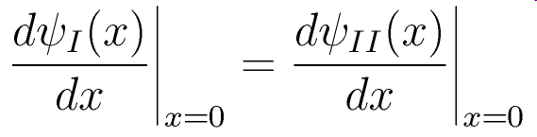
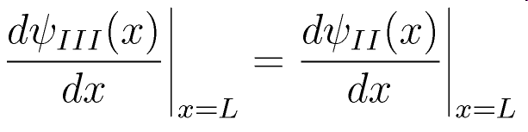
Boundary Conditions
There are 4 unknowns: A, B, C and G.
As before we can write 2 equations so that ψ(x) is continuous:
and
We can get two more equations by the other boundary conditions that the first derivative is also continuous, i.e.,
I
II
III

Slide 14
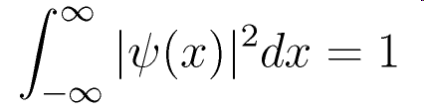
Normalization
In fact, we can write one more equation due to normalization:
which must now be integrated over all three regions since ψ(x) is non-zero in all three regions.
I
II
III

Slide 15



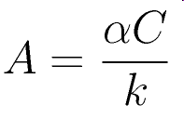

Relationship between Unknowns
Solving the 5 equations (4 boundary conditions + normalization) will allow us to get A, B, C and G (4 unknowns) plus the quantization condition for E.
Boundary conditions at x = 0 gives:
I
II
III

Slide 16


Relationship between Unknowns
Boundary conditions at x = L:
I
II
III

Slide 17
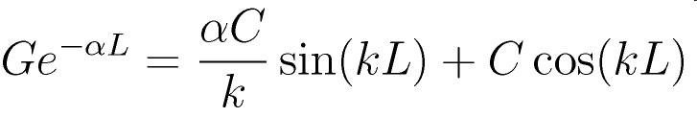

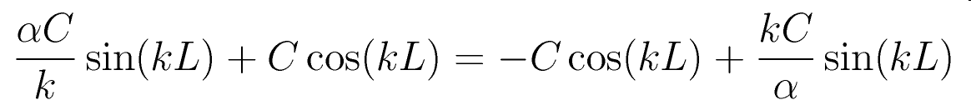
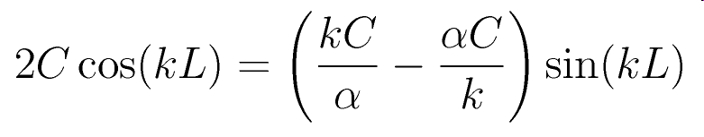
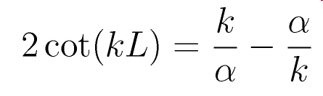
Relationship between Unknowns
Substituting B = C and A = αC/k into the previous two equations:

Slide 18
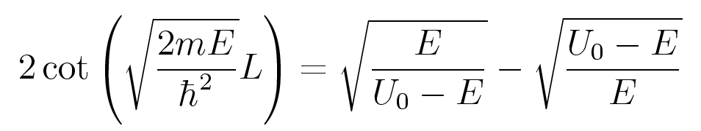
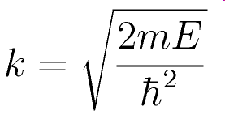
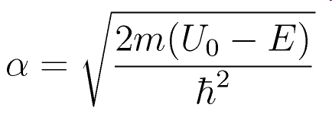


Quantization Condition
Note that we have got the quantization condition!
where
and
In the limit where U₀ → ∞, α → ∞ while k remains finite and so
as before
Unfortunately, the above is a transcendental equation and we cannot solve it analytically. We would need to use either numerical or graphical methods to proceed further. (Will not expect you to proceed further than this in the examinations – but you need to know the qualitative aspects of the solutions!!)

Slide 19
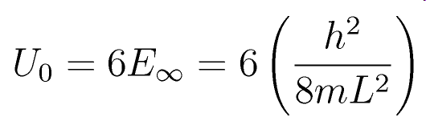
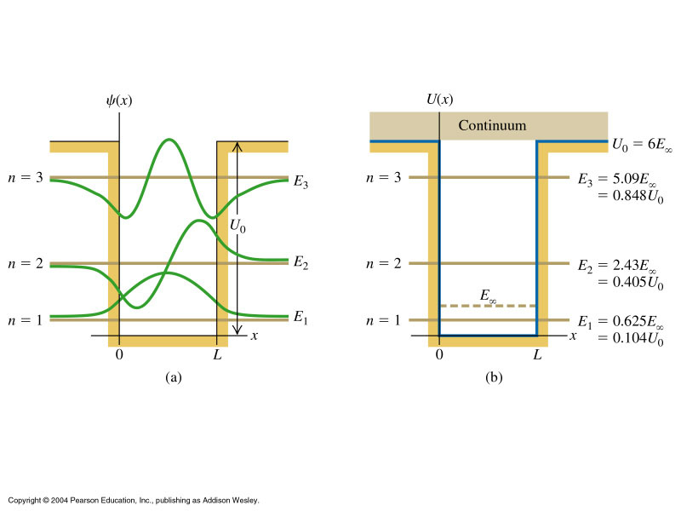
Specific Example: U₀ = 6E∞
Below are the wavefunctions calculated for the specific case where U₀ equals to 6 times the energy of the ground state in the infinite potential well E∞, i.e.,
http://phet.colorado.edu/en/simulation/bound-states
There are only three states.
Similar to the case with infinite potential, each higher state has another turning point or node.
The wavelengths are longer than that of infinite potential ⇒ lower energy levels.
Wavefunction inside “forbidden” region is non-zero.

Slide 20
Specific Example: U₀ = 6E∞
The energy levels are calculated in a similar fashion as we had done earlier and are given below.
In the continuum, the energy levels are continuous. Wavefunction is that of free particle, with shorter wavelength in region II (0 ≤ x ≤ L)
Compared to the infinite potential case, the energy levels are all lower.
Separation between adjacent levels still increases as n increases, but E_{n} does not increase as n².
Particles are allowed to have energy E above U₀. In this case, the levels are not discrete and the particle can take have any value of energy.

Slide 21
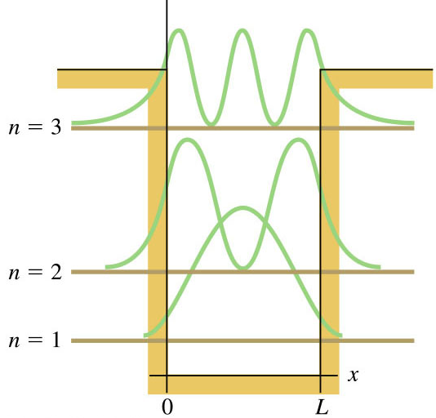

Specific Example: U₀ = 6E∞
The probability density is shown for the different levels.
As in the infinite potential case, the probability density at x = L/2 is either maximum (n = odd) or zero (n = even).
We should still normalize the wavefunction. After simplifying, A, B and G can all be written in terms of C and other constants. So we can normalize to get ψ(x) independent of A, B, C and G.

Slide 22
Example
An electron is trapped in a square well with width 0.50 nm.
  Find the ground state energy if the well is infinitely deep.
  If the actual depth is six times that of the ground state energy found in (a), find the energy levels.
  If the atom makes a transition from a state with energy E₂ to energy E₁ by emitting a photon, find the wavelength of the photon. In what region of the electromagnetic spectrum does the photon lie?
  If the electron is initially in the ground level, what is the minimum energy a photon must have to liberate it from the well? In what region of the spectrum does the photon lie?

Slide 23
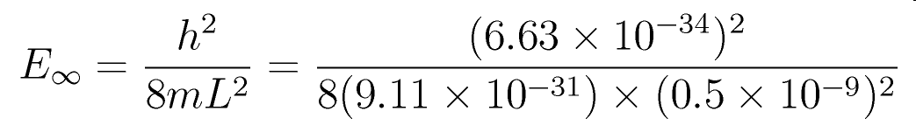

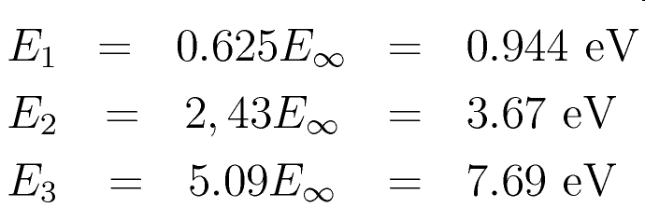
Example
An electron is trapped in a square well with width 0.50 nm.
  Find the ground state energy if the well is infinitely deep.
Using the same notation E∞ as in previous slide,
  If the actual depth is six times that of the ground state energy found in (a), find the energy levels.

Slide 24
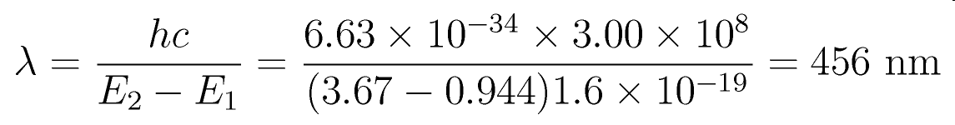
Example
  If the atom makes a transition from a state with energy E₂ to energy E₁ by emitting a photon, find the wavelength of the photon. In what region of the electromagnetic spectrum does the photon lie?
Photon is in the visible region of EM spectrum.
3.67 eV
0.944 eV

Slide 25



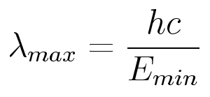
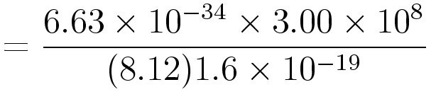
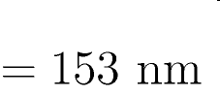
Example 4
  If the electron is initially in the ground level, what is the minimum energy a photon must have to liberate it from the well? In what region of the spectrum does the photon lie?
To be liberated, the final energy of the electron E_{f} ≥ U₀ (= 6E∞). Therefore the minimum energy is:
0.944 eV
(Ultra-violet)

Slide 26
Particle in a ring

Slide 27
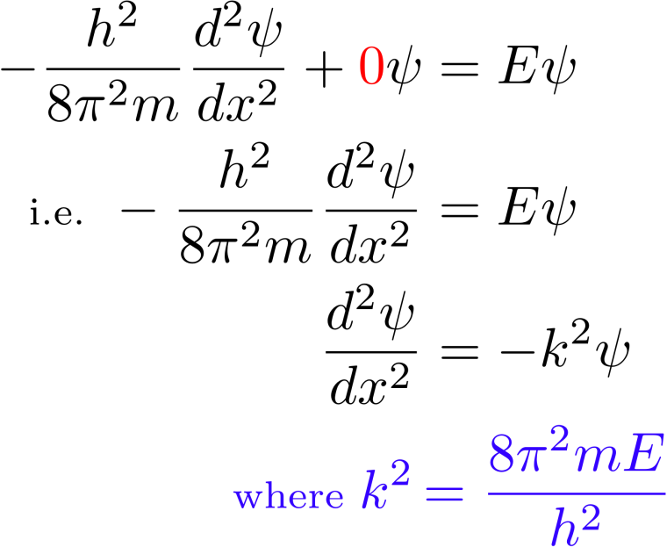
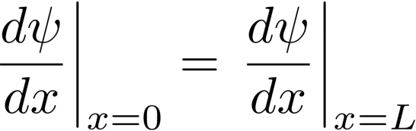

Particle in a ring
Lets modify our box to be curved so that there are no boundaries at the ends.
The Schrodinger equation for this situation is no different from the previous.
L
normal box
L
cyclic box
However the boundary conditions become
and

Slide 28
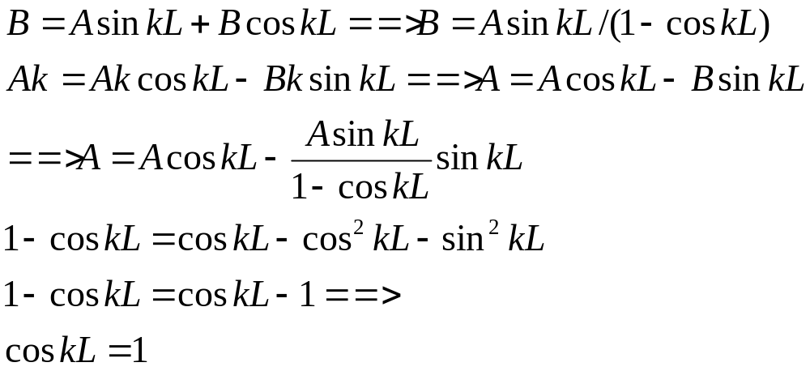
Particle in a ring
The most general wave function is:
Lets use these in the boundary conditions

Slide 29

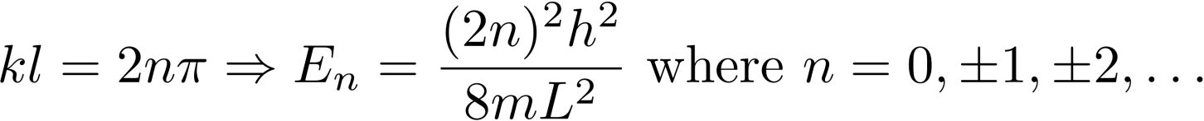
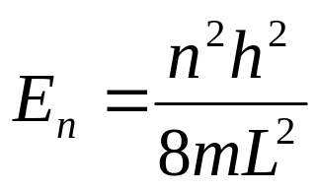
Particle in a ring
Continuing from previous slide:
Whence,
Note the difference between the quantized energy with that of the particle in 1D potential box.

Slide 30
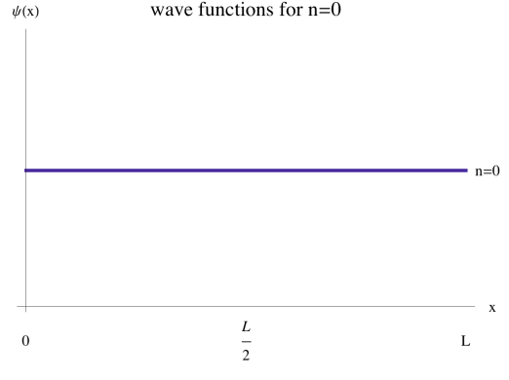
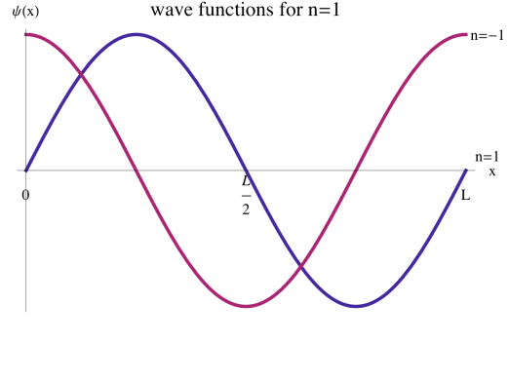
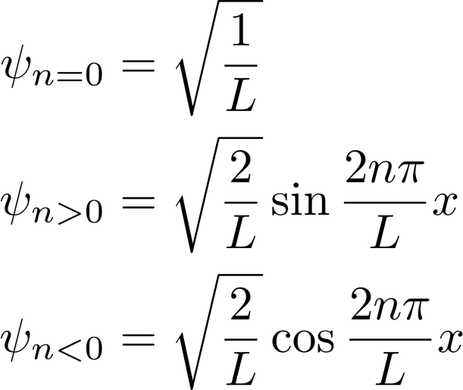
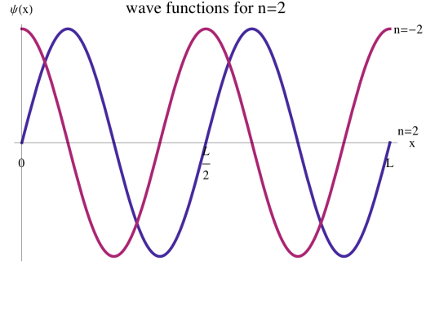

Particle in a ring
Working a bit further and normalizing will lead to the solutions:
Note that n can now be negative.
Note also that both +n and –n have the same energy! (degenerate solutions)
Therefore there are more states per energy

Slide 31
Simple Harmonic Oscillator

Slide 32
Simple Harmonic Oscillator
The simple harmonic oscillator is a very important example in QM. The wavefunctions and energy levels shared many characteristics of the square potential wells that we have dealt with earlier. But there are also significant differences.
In principle we can solve fully but it is still mathematically very demanding – and so we will just verify one of the solutions and get a qualitative feel of what we can gain from the solutions. In particular, we will try to understand how the energy levels are distributed.
Despite the fact that this seems to be an ideal system where the potential is exactly quadratic in x, it does represent realistically many physical systems, such as the forces between two atoms in a molecule, at least within a range of x near the equilibrium point.

Slide 33




Simple Harmonic Oscillator
You have learnt simple harmonic oscillation in your high school or A-level. Force is proportional to displacement and acts always towards the equilibrium position (as seen in the example of the spring system below):
The mass oscillates with a frequency
Note that we use k’ for the spring constant instead of k which we had used for the wave number.

Slide 34





Simple Harmonic Oscillator
In quantum mechanics we deal more with energy than force. The potential energy is related to the force by:

Slide 35

SHM in Quantum Mechanics
Putting this expression of U(x) into the SE, we get
If you have not solved the above differential equation before, it will not be easy to see how it could be solved! You may try to substitute possible equations into the above and by trial and error, you may stumble upon the right ones. One thing that will guide you is that the equation must tend towards zero quickly for x → ± ∞ so that the function can be normalized. There are no other boundary conditions to guide you since the potential varies smoothly over the whole range of x, i.e., we do not divide into regions as before.

Slide 36


A Possible Solution?
One solution that seems promising is
where b and C are constants
It goes towards zero very quickly as x → ± ∞ and will result in a term with [x²ψ(x)] needed in the second term of the SE when ψ(x) is differentiated twice.

Slide 37









Substituting into SE:
This is true for any value of x and ψ(x) is not 0 everywhere:

Slide 38



First solution of SHO
So we have obtained the first solution of the simple harmonic oscillator!
And the energy of this state is:
Subscript of “0” was put in in anticipation of the different energy level n that we will encounter next. Unlike earlier example, it is traditional in SHO to start the ground state at n = 0, instead of n = 1.

Slide 39





Normalization
We still need to normalize the wavefunction to obtain expression of C in terms of known constants.
But
(From integral table, will be given if needed in exams)
Taking

Slide 40






Minimum Energy
ψ₀(x) is just one of the solutions. We may justify that this is the lowest energy level by the Heisenberg Uncertainty Principle.
Consider a classical harmonic oscillator with total energy ½ ħω, moving about O with amplitude A. Then
Max momentum:
Product is the smallest allowed by HUP – so E = ½ ħω is the smallest energy allowed!

Slide 41


Other Solutions
We could try to guess and verify other wavefunctions – logically there should still be exp(-bx²), but is now multiplied by a polynomial of order n (greatest power) to get ψ(x) similar to the solutions of the finite square well, i.e., having one extra turning point for the next higher energy level, etc.
In fact, that is true and the first four wavefunctions are indicated below and in the next slide.
The polynomials are known as Hermite Polynomials.
where

Slide 42



Hermite Polynomials
Normalization constant
where
SHO

Slide 43



Energy Levels
The most interesting aspect of the simple harmonic oscillator is its energy levels. They are extremely simple and is given by:
n = 0, 1, 2, …
These energy levels correspond to the wavefunction ψ_{n}(x) in previous slides
The energy difference between adjacent levels is
Note again that the zero-point energy is not 0 but ½ħω.

Slide 44

Probability Density
As before, we can plot the probability density |ψ(x)|² from ψ(x). The first four levels are shown below:
Classical probability

Slide 45


Probability Density
The probability density shows a fluctuation not too dissimilar from finite square well case. At x = 0, the probability is either maximum or 0.
The spacing between the zeros of |ψ(x)|² is shortest near the x = 0 and increases as x approaches ±A.
The blue line is the classical probability of finding the particle around x and is inversely proportional to its speed there. Notice that the average of quantum probability approach the classical limit as n increases.
The probability of finding the outside its classical turning point is again non-zero.
Classical probability

